Slide 1

VQA Voyager: Voice-Based Visual Question Answering for Cultural Heritages in Kathmandu Valley
Team Members
Arnab Manandhar
Chandra Mohan Sah
Looza Subedy
Santosh Acharya
(THA077BEI008) (THA077BEI017) (THA077BEI024) (THA077BEI040)
Under the Supervision of
Associate Prof. Suramya Sharma Dahal
Department of Electronics and Computer Engineering
Institute of Engineering, Thapathali Campus
August, 2024

Slide 2
Presentation Outline
• Motivation
• Introduction
• Objectives
• Scope of Project
• Project Applications
• Methodology
• Dataset Analysis
• Results
• Discussion and Analysis
• Remaining Tasks
• References

Slide 3
Motivation
Enhance tourists' cultural understanding and appreciation
Bridge information gaps at heritage sites
Provide interactive, real-time artifact information
Utilize AI for enriched tourist experiences
Foster deeper engagement with cultural heritage
Make heritage sites more accessible
Empower tourists with instant historical insights

Slide 4
Introduction
AI automates mundane tasks, saving time and effort
Opens new possibilities for cultural understanding
CV and NLP methods have potential to significantly improve tourists knowledge
VQA: Promising CV and NLP task
Most common VQA model answers image-related questions
Image and question is taken as input based on which accurate predictions is done

Slide 5
Objectives
To develop a Visual Question Answering (VQA) tool that answers questions based on the context of the captured image
To capture images and create a voice-based app that allows the user to ask questions about the image

Slide 6
Scope of Project
Develop an app to help tourists identify artifacts
Integrate Visual Question Answering (VQA) for image processing and natural language processing
Implement text-to-speech and speech-to-text using Android Speech Recognition features
Provide accurate answers to queries about the captured artifacts
Ensure an intuitive and accessible experience for tourists

Slide 7
Project Applications
Assistance in exploring world heritage sites for tourists
Assist users in identifying artifacts and understanding their history
Enhance the cultural experience with detailed information on demand
Provide educational insights about historical objects and artifacts
Enhance engagement through interactive and personalized learning
Promote cultural appreciation and preservation through accessible information

Slide 8
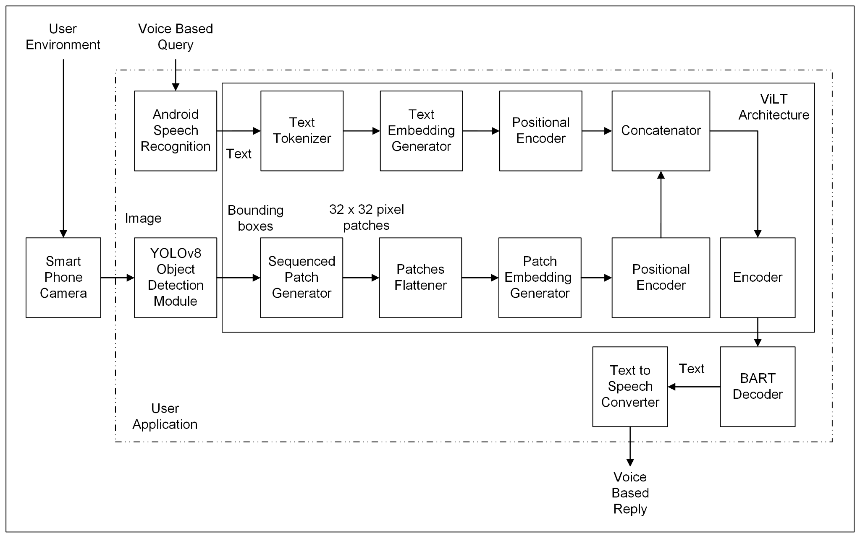
Methodology - [1]
System Block Diagram
Figure: System Block Diagram

Slide 9
Methodology - [2]
Description of Working Principle
User can capture a picture and ask a voice based question
Android speech recognizer converts speech to text
The objects in the picture are identified by YOLOv8 model
The bounding box region and question are passed through ViLT model
The ViLT model provides a joint embedding of image and question
The joint embedding is passed to BART decoder
BART decoder provides a descriptive answer
The textual answer is converted into voice based reply using android text-to-speech

Slide 10
Methodology - [3]
YOLOv8 - [1]
YOLOv8 takes image as an input and outputs the bounding box of the objects
Three components: Backbone, Neck and Head
Backbone
Extracts features from images using multiple layers
Neck
Merges feature maps from different stages of the backbone to capture information at various scales
Head
Predict bounding boxes, objectness scores, and class probabilities for each grid cell in feature map

Slide 11
Methodology - [3]
YOLOv8 - [2]
The training parameters for YOLOv8 are:
Hyperparameters | Values
Epochs | 100
Batch size | 16
Image size | 640
Optimizer | AdamW
Learning rate | 0.01
Dropout | 0.0
Hyperparameters | Values
Freeze | null
IoU | 0.7
Box | 7.5
Class | 0.5
DFL | 1.5

Slide 12
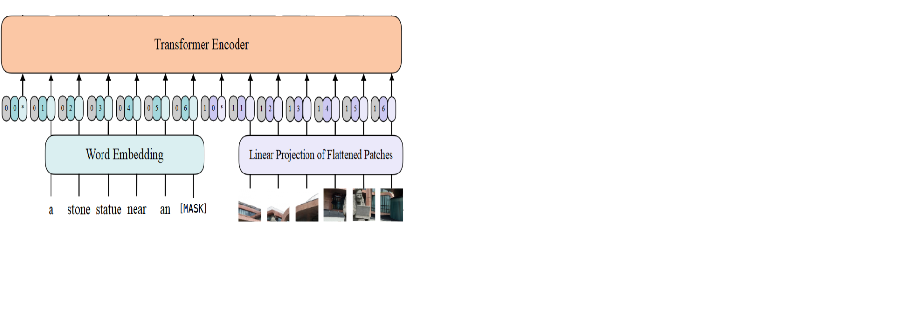
Methodology - [4]
ViLT (Vision and Language Transformer) - [1]
Processes both visual and textual information directly
The image is divided into fixed-size patches of (32x32)
Positional encoding is added to retain spatial information
Figure: ViLT encoder

Slide 13
Methodology - [4]
ViLT (Vision and Language Transformer) - [2]
Text is tokenized as well and embedded with positional encoding
The image embedding and text embedding are combined and fed into the transformer encoder
The model outputs a contextual embedding of [number of image-text pairs, sequence length, embedding dimension]
Sequence length : number of tokens or patches in the sequence
Embedding dimension: size of the feature vectors for each token or patch ( 768 dimensions )

Slide 14
Methodology - [5]
BART (Bidirectional Autoregressive Transformer)
Utilizes separate encoder and decoder components, enabling sequence-to-sequence learning
Uses bidirectional encoder and auto regressive decoder
BART Decoder
It predicts the next tokens by taking the previously generated tokens into consideration (Auto-regressive)
We only use BART decoder, which accepts the context embedding from ViLT Encoder
Generates the answer based on given embeddings

Slide 15
Methodology - [6]
Android Application - [1]
What is Flutter?
Open-source software development kit (SDK)
Uses Dart Programming Language enabling hot reload
Purpose in project
Create attractive and responsive User Interface
Send input parameter (image and text) to server
Receive the response from server

Slide 16
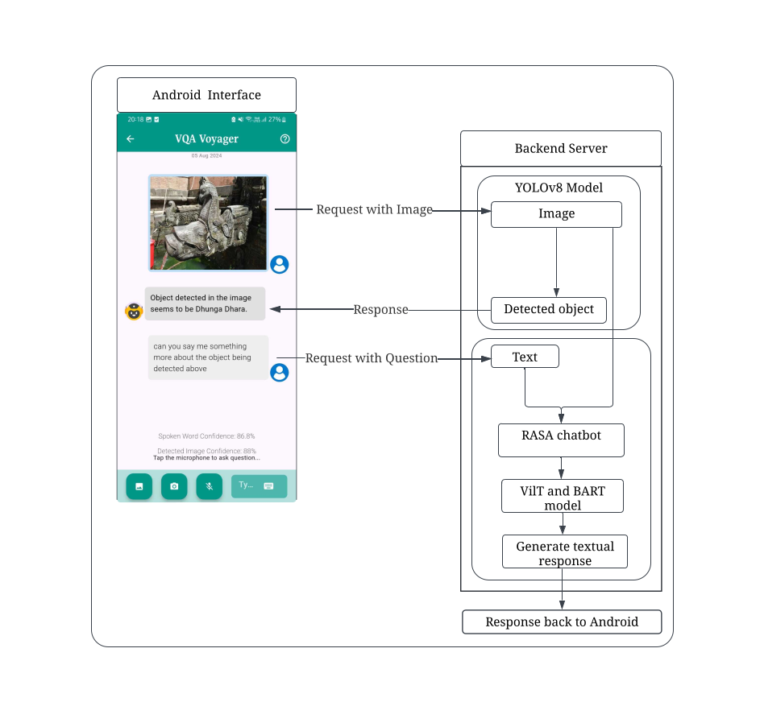
Methodology - [6]
Android Application - [2]
Communication Interface
Communication Hierarchy between
various components can be seen in the diagram
Figure: Application Communication Interface

Slide 17
Methodology - [7]
RASA Chatbot - [1]
What is Rasa?
Open-source framework
Conversational AI
What is Rasa chatbot?
AI-driven system that understands user inputs
Responds via NLP
Purpose in project
Visualize chatbot interactions during initial development stage
Facilitate an engaging conversation for users

Slide 18
Methodology - [7]
RASA Chatbot - [2]
Rasa chatbot has been used with Web Application
Designed for user interaction
Facilitates image processing and chat functionality
Rasa chatbot workflow
Users upload images through the web interface
Engage in chat to receive responses and processed image
Domain.yml file sets up the chatbot framework with intents and entities
Rules.yml file specifies dialogue rules to ensure consistent responses
Custom actions integrate the YOLO model for object detection

Slide 19
Dataset Analysis - [1] Data Collection - [1]
Images were collected through site visits around Kathmandu Valley
Additional images obtained by web scraping from Shutterstock and existing datasets
The final dataset contains
6812 images
12 classes

Slide 20
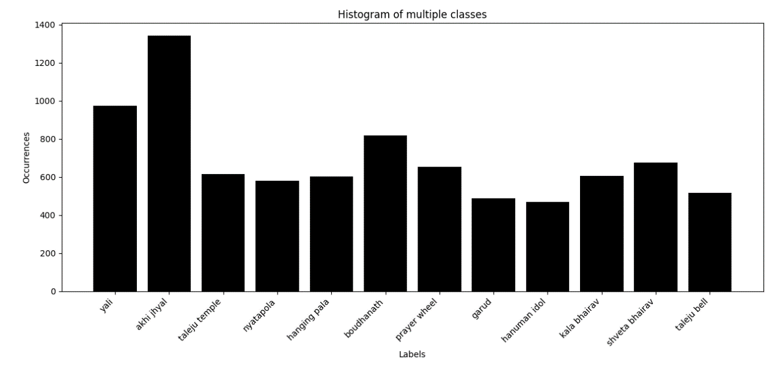
Dataset Analysis - [1] Data Collection - [2]
Distribution of images in dataset
Figure: Dataset image distribution

Slide 21
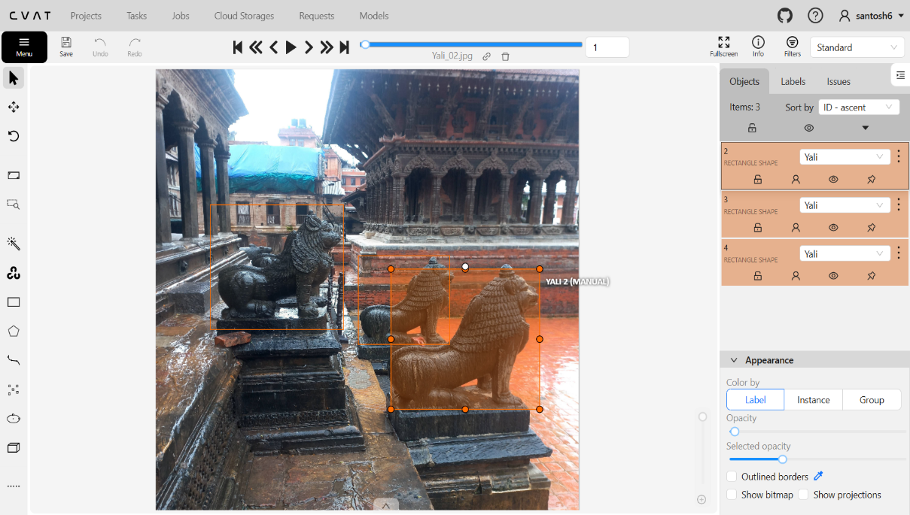
Dataset Analysis - [2] Data Annotation - [1]
CVAT is used for annotation
of images
Bounding box and class labels added
Exported in YOLO format for training
Figure: Annotation using CVAT

Slide 22
Dataset Analysis - [3] Data Augmentation - [1]
Five images generated using random combination of augmentation techniques
Horizontal flipping
Brightness and contrast
Gamma adjustments
Gaussian noise and blur
Rotation
Figure: Dataset Augmentation

Slide 23
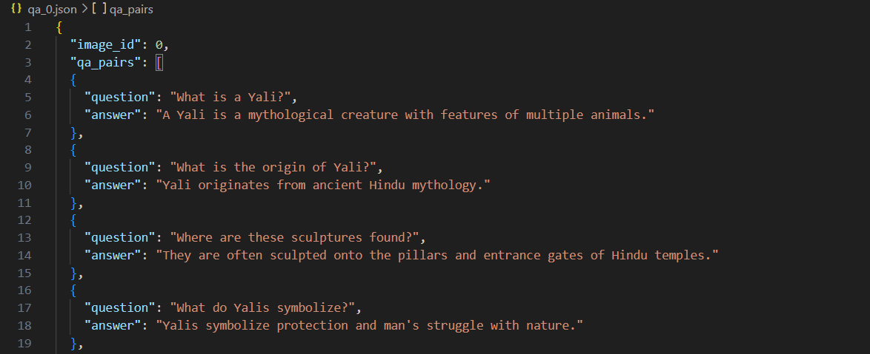
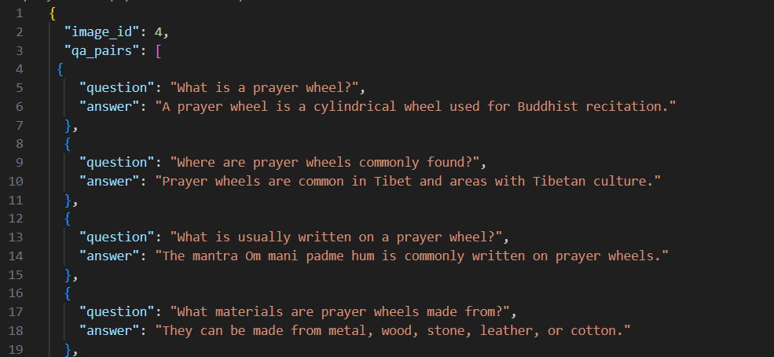
Dataset Analysis - [4]
Question answering pairs has been illustrated along with about 18 QA pairs per object in average
Around 218 question answer pair has been created till now
Figure: Question Answer Pairing

Slide 24
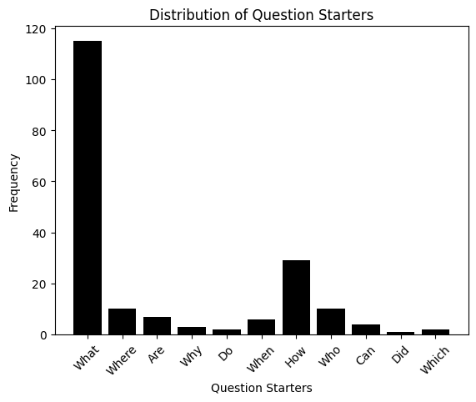
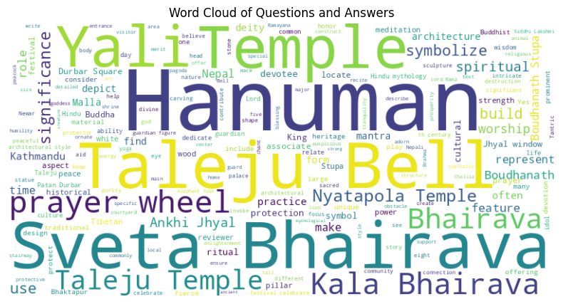
Dataset Analysis - [5]
The graphs representing the question types and most frequently used words in the dataset
Figure: Graph of question answer types

Slide 25
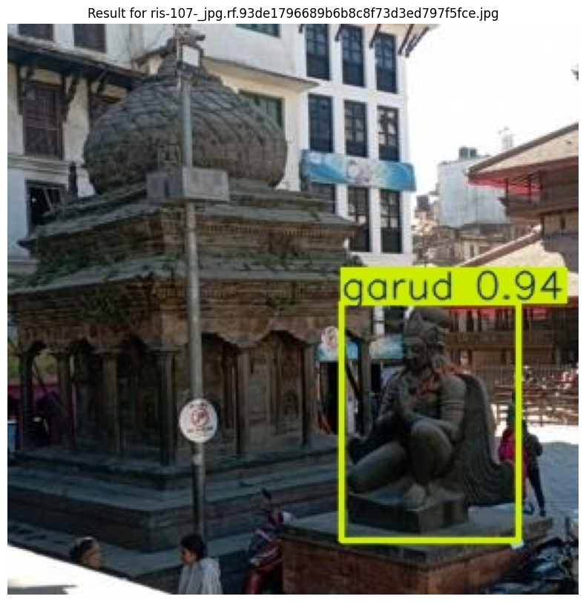
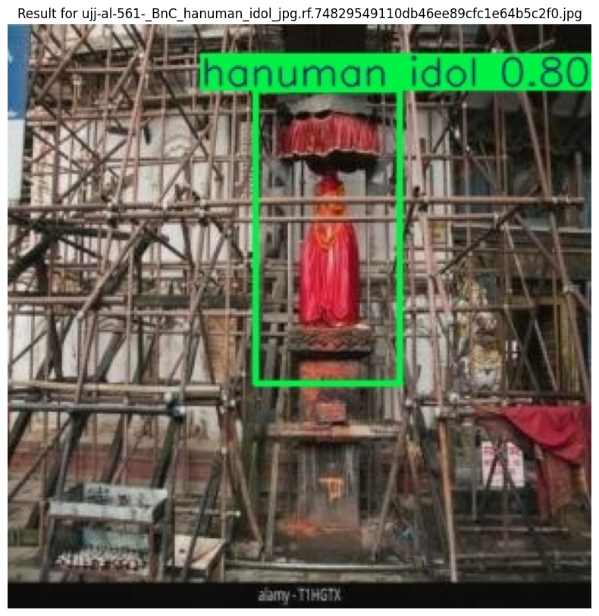
Object Detection Module - [1]
The inference results of YOLOv8 are:
Results - [1]
Figure: YOLOv8 inference results

Slide 26
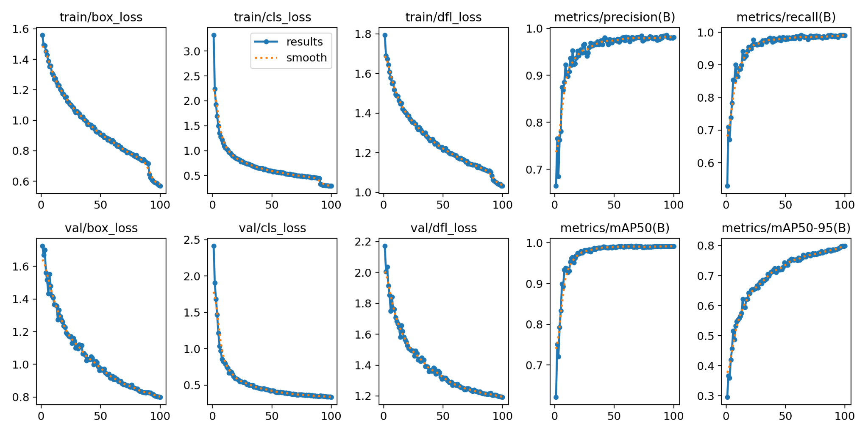
Object Detection Module - [2]
Losses and metrics curve
Results - [1]
Figure: Losses and metrics curve

Slide 27
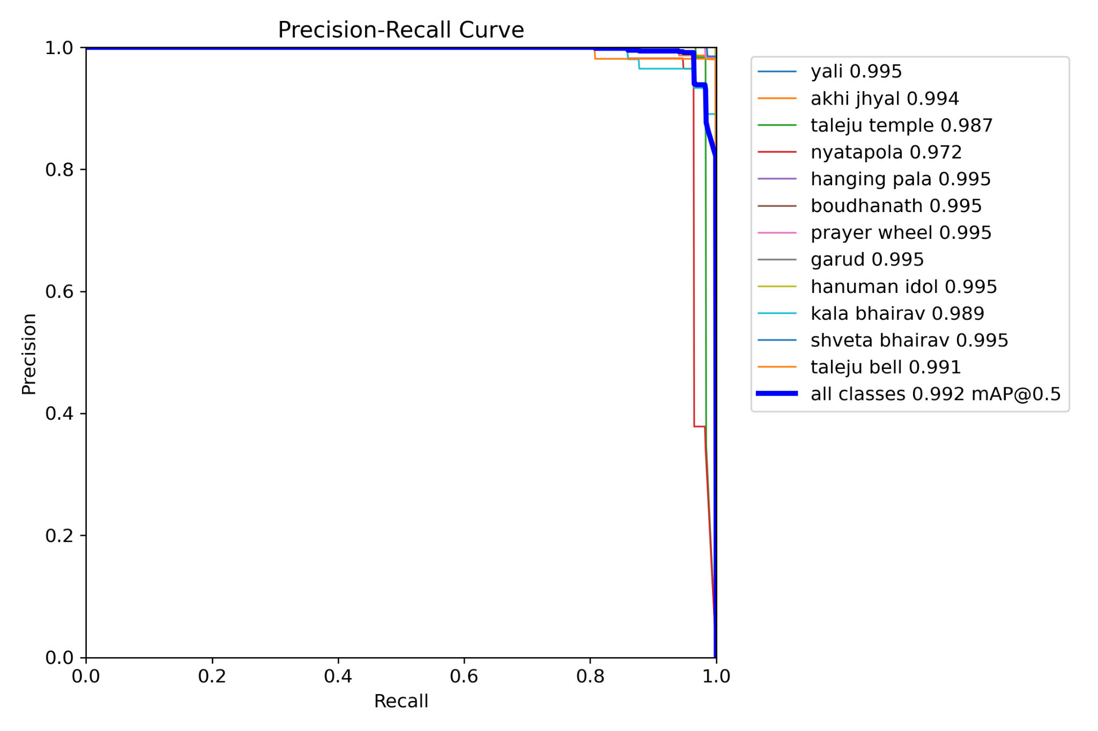
Object Detection Module - [3]
Precision Recall curve
Results - [1]
Figure: Precision recall curve

Slide 28
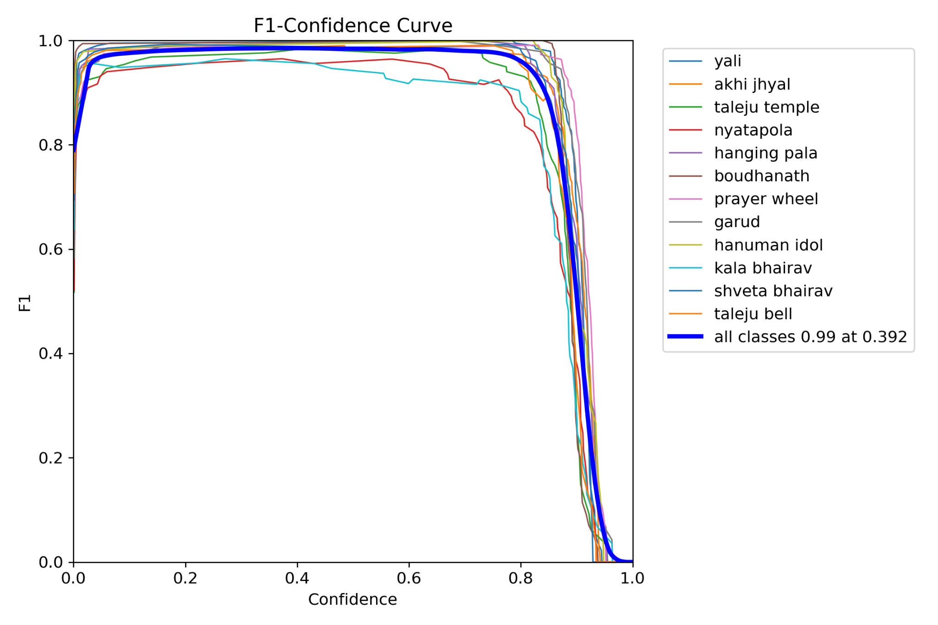
Object Detection Module - [4]
F1-score curve
Results - [1]
Figure: F1 score curve

Slide 29
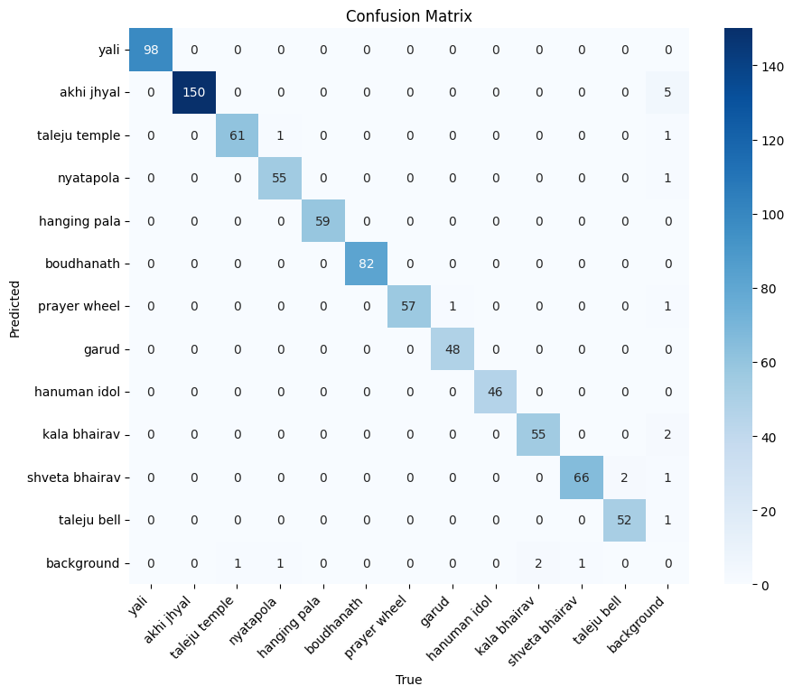
Object Detection Module - [5]
Confusion Matrix
Results - [1]
Figure: Confusion Matrix

Slide 30
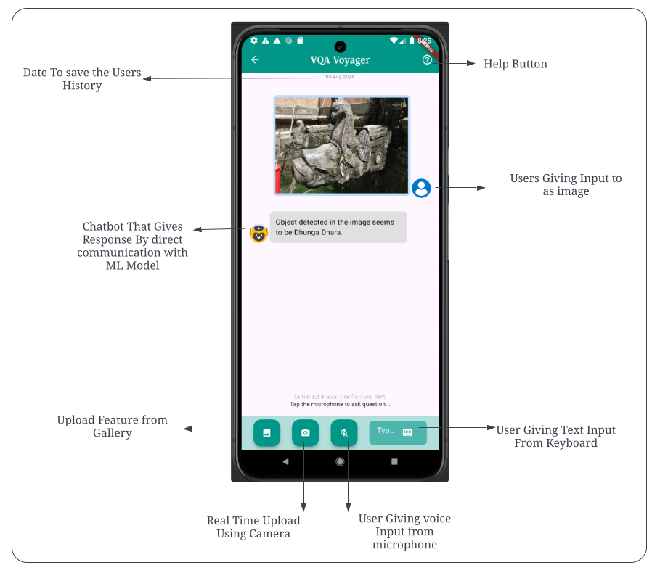
Android Application
Application Interface
Results -[2]
Figure: Application Interface

Slide 31
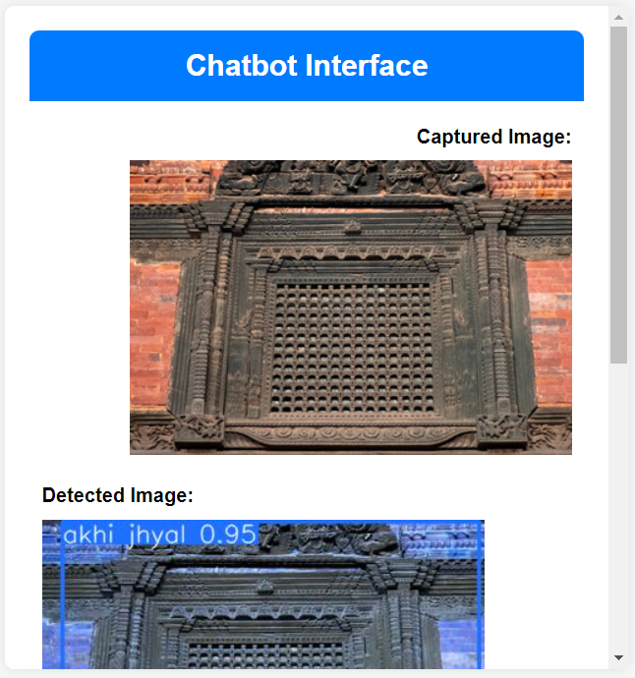
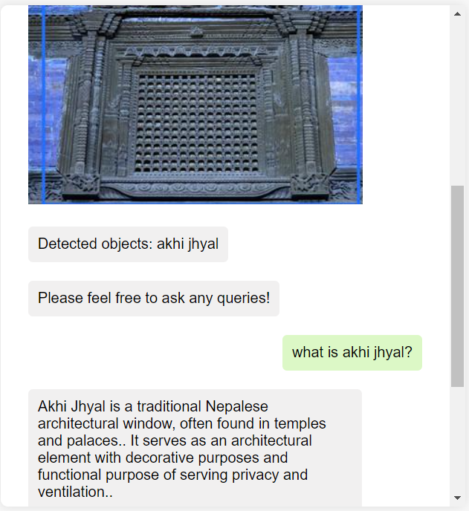
Rasa Chatbot
Chatbot Integration
Results -[1]
Figure: Chatbot Interface

Slide 32
Discussion and Analysis - [1]
The maximum values of evaluation metrics were obtained to be as follows:
Precision: 98.62%
Recall: 99.17%
mAP50: 99.23%
mAP90: 79.89%
For android “Speech_to_text:6.6.2” package is used for voice to text generation whereas “image_picker” package is used to open gallery and camera

Slide 33
Discussion and Analysis - [2]
RASA has been used to create the chatbot
Chatbot has currently been used in a website hosted locally
Chatbot is able to integrate YOLO detection model for input
Interface displays original and object detected images in the chat
Needs to be trained on more probable questions and answers for further interaction
Deploying the Chatbot on a mobile application aligns more with the project objective

Slide 34
Remaining Tasks
Augment and increase the size of QA-pairs
Train and test the ViLT encoder and BART decoder on the custom dataset
Create RESTful API
Implement contextual management in chat
Host the above-trained model in a server for Real-time Communication

Slide 35
References - [1]
[1] |  | M. M. a. M. Fritz, "Towards a Visual Turing Challenge," 2015.
[2] |  | S. A. e. al, "VQA: Visual Question Answering,," in 2015 IEEE International Conference on Computer Vision (ICCV), Santiago, Chile, 2015.
[3] |  | M. R. Mateusz Malinowski, "Ask Your Neurons: A Neural-based Approach to Answering Questions about Images," in Conference: International conference on computer vision (ICCV), Santiago, 2015.
[4] |  | R. K. a. R. Z. Mengye Ren, "Image Question Answering: A Visual Semantic Embedding Model and a New Dataset," in Deep Learning Workshop at ICML 2015, 2015.
[5] |  | N. P. H. S. B. H. Hyeonwoo, "Image Question Answering Using Convolutional Neural Network with Dynamic Parameter Prediction," in 2016 IEEE Conference on Computer Vision and Pattern Recognition (CVPR), Las Vegas, 2016.

